Slide 1
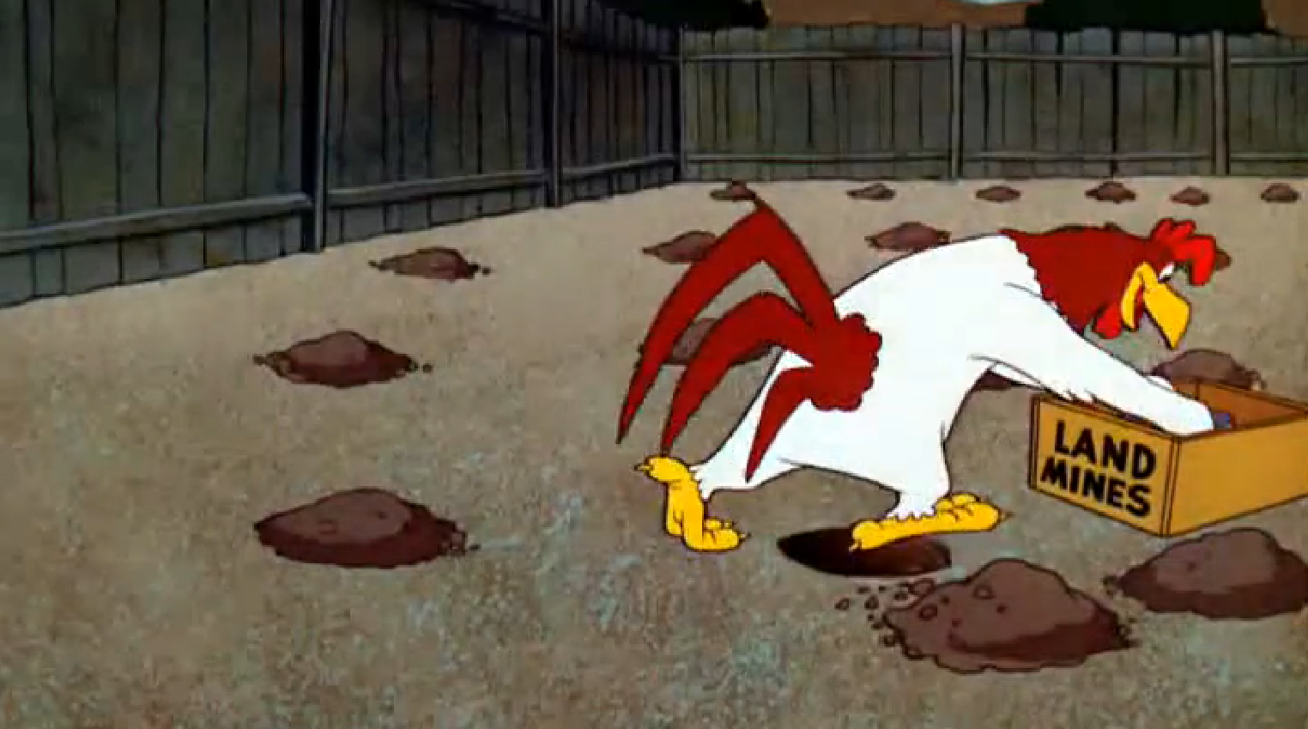
Minesweeper
Michael Somkuti, Luca Polgar,
Bryan Almonte, Catherine Crossin, Joshua Quijano
Pictured: Foghorn Leghorn laying mines in 1961 cartoon “Strangled Eggs”
Notes:
Josh

Slide 2
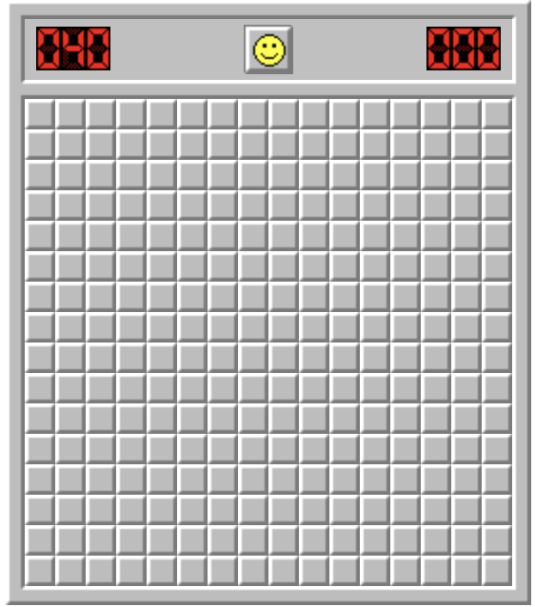
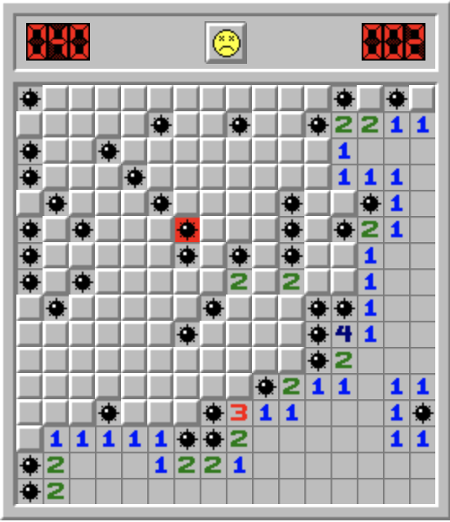
What is minesweeper?
Single player game where the objective is to flag all the bombs in a grid
Each square is assigned a number based on how many bombs are in the 8 surrounding squares
Player loses if they click on a bomb
Player wins if they reveal every numbered square and flag every bomb
Different levels of difficulty based on size of board and amount of bombs
Notes:
Josh

Slide 3
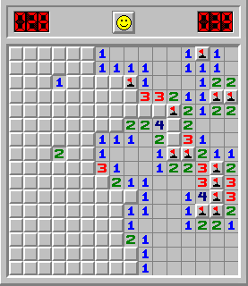
How To Play
The player starts by clicking on a square in the grid
Once a square is clicked on, the game then reveals what is behind the square.
If the square clicked on has a zero, the game reveals its surrounding squares. If another zero is revealed, then the game repeats this process until there are no more zeros around. As a result, a perimeter of numbers are revealed.
If a square is clicked on with a number greater than zero, the number is revealed.
Players can flag squares where they suspect a bomb is to avoid accidental clicking
Notes:
Josh

Slide 4
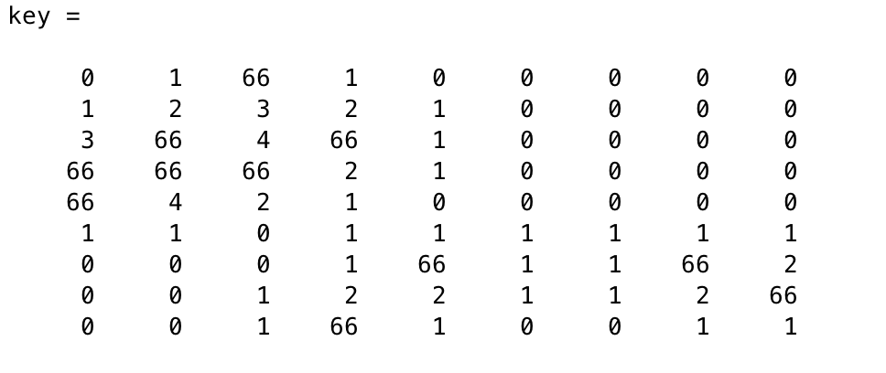
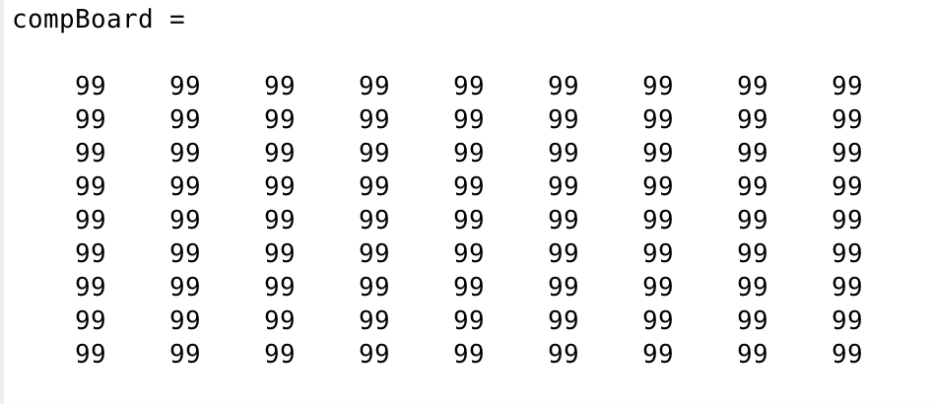
Create the board
We created two equal size matrices
9 x 9 matrix for easy, 16 x 16 matrix for medium, and 24 x 24 matrix for hard
The first matrix is the “key” which has the solution to the game
The second matrix is the board that the computer plays on
10 bombs for easy, 40 bombs for medium, and 99 bombs for hard
We navigated through the matrix on the code by using indexing
Notes:
Katie

Slide 5
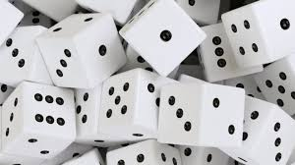
Strategy 1: Random Clicking
The easiest but worst way to play is by random clicking
Our initial code reflects a strategy is random clicking
For a million trials, the probability on winning on MATLAB is 1.29*10⁻⁴, so basically 0
We used the function randomWins which randomly picks squares to click on
Notes:
Katie

Slide 6

Strategy 2: Flagging
Check the 1’s and if there is only one unrevealed square around it you can flag that square
Same with the 2’s if there are only two unrevealed square around it, so on.
If there are not any more numbers found, then check the 1’s and the number of flagged squares around it. If the square numbered 1 has one flag around it then you can click on the remaining surrounding squares
The same can be done as above for any number, as long as there is the same number of flags around the square as number of the square
If none of the above steps are possible, then click randomly
We used the function lstrat to implement the strategy above
Notes:
Luca

Slide 7
Process Of Creating Code
9 functions we used:
randomWins: function that implements the random strategy
Lstat: function that implements the flagging strategy
numAssign: assigns number to each square that correlates to number of bombs around square
checker: checks that all squares in the board
cascade1: reveals square when player clicks on a zero
revealSquares: what computer sees after each click
zerosInSquare: finds which squares are have zero assigned to them
flagger: flags and reveals the appropriate squares in the flagging strategy
revealFlagSquares: opens all the non-flagged squares
Notes:
bryan

Slide 8
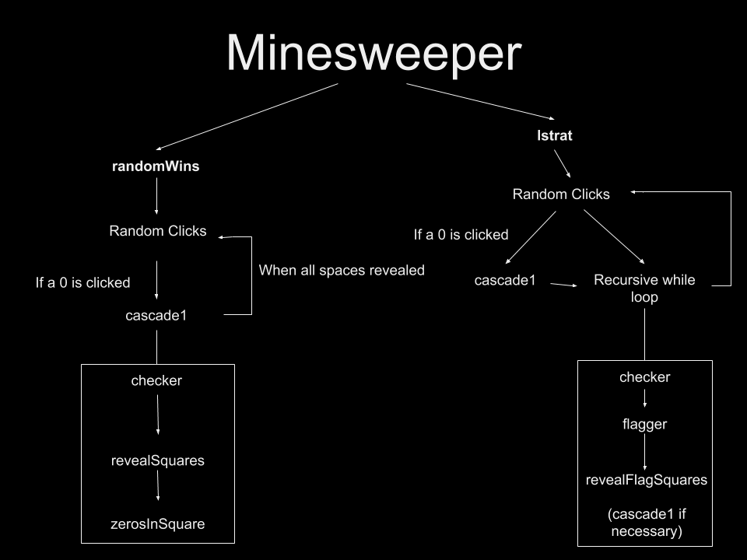
Code File Flowchart
Notes:
Michael left
Luca right

Slide 9
Now, let’s run for Monte Carlo applications
→ Probabilities ←
→ Random Sampling ←
→ Frequency Distributions ←

Slide 10


Slide 11
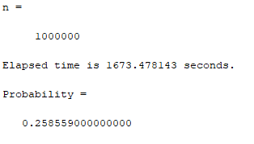
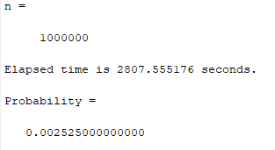
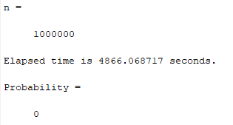
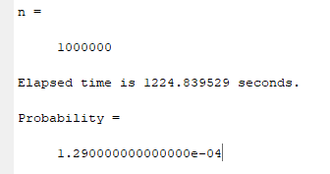
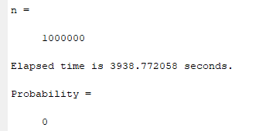
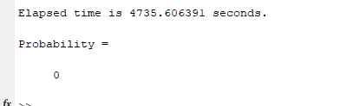
Easy Mode, lStrat
Medium Mode, lStrat
Expert Mode, lStrat
Easy Mode, randomStrat
Medium Mode, randomStrat
Expert Mode, randomStrat
Notes:
We don’t have a histogram for random wins because basically 0
We don’t have a histogram for lStrat expert because when we ran it overnight it only got 1 win in 24 turns

Slide 12
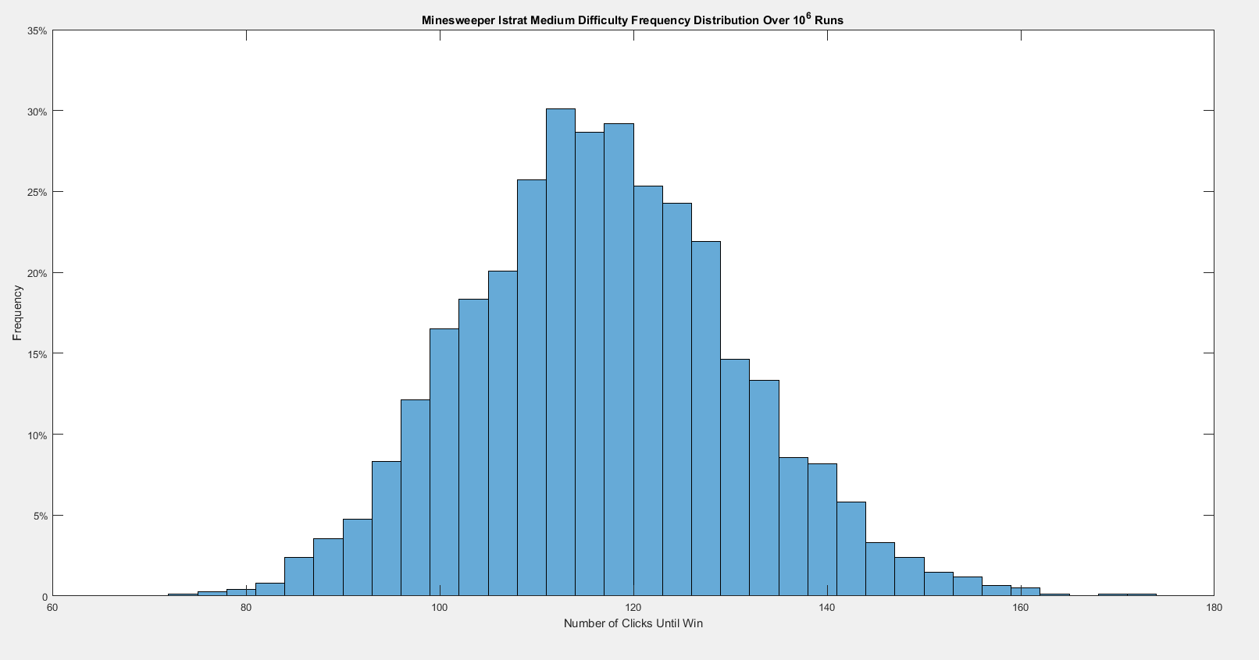
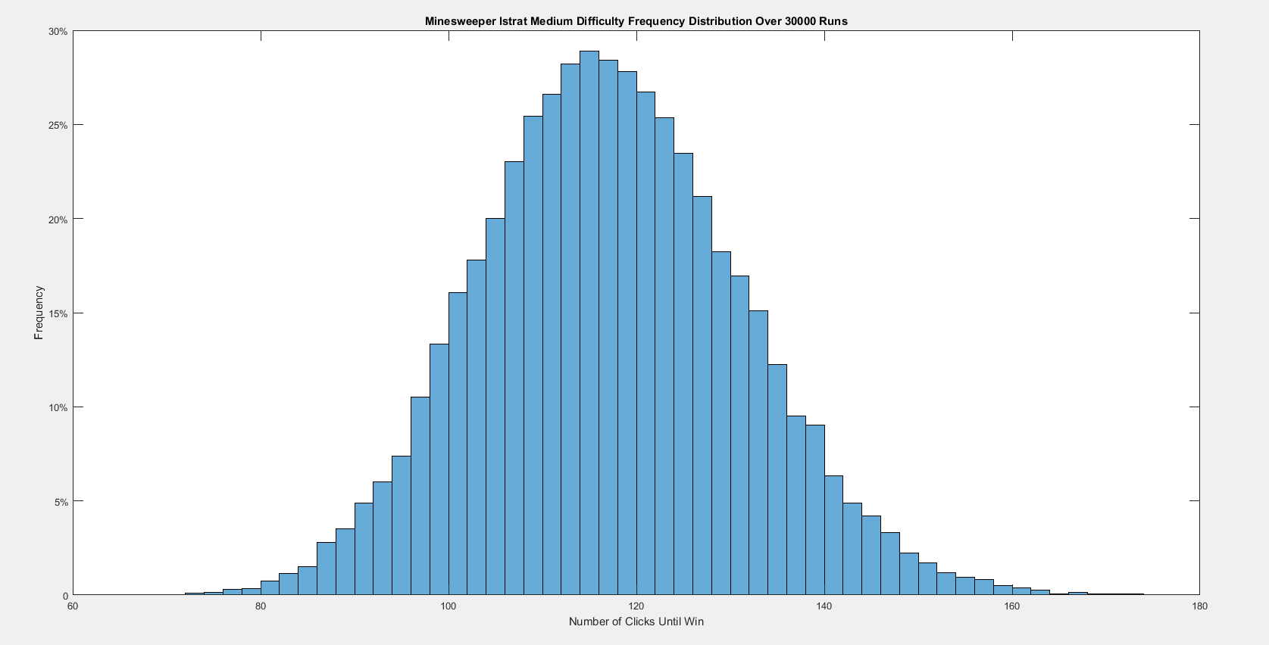
Notes:
2525 wins
Left axis is the frequency at which the computer won with a certain number of clicks

Slide 13
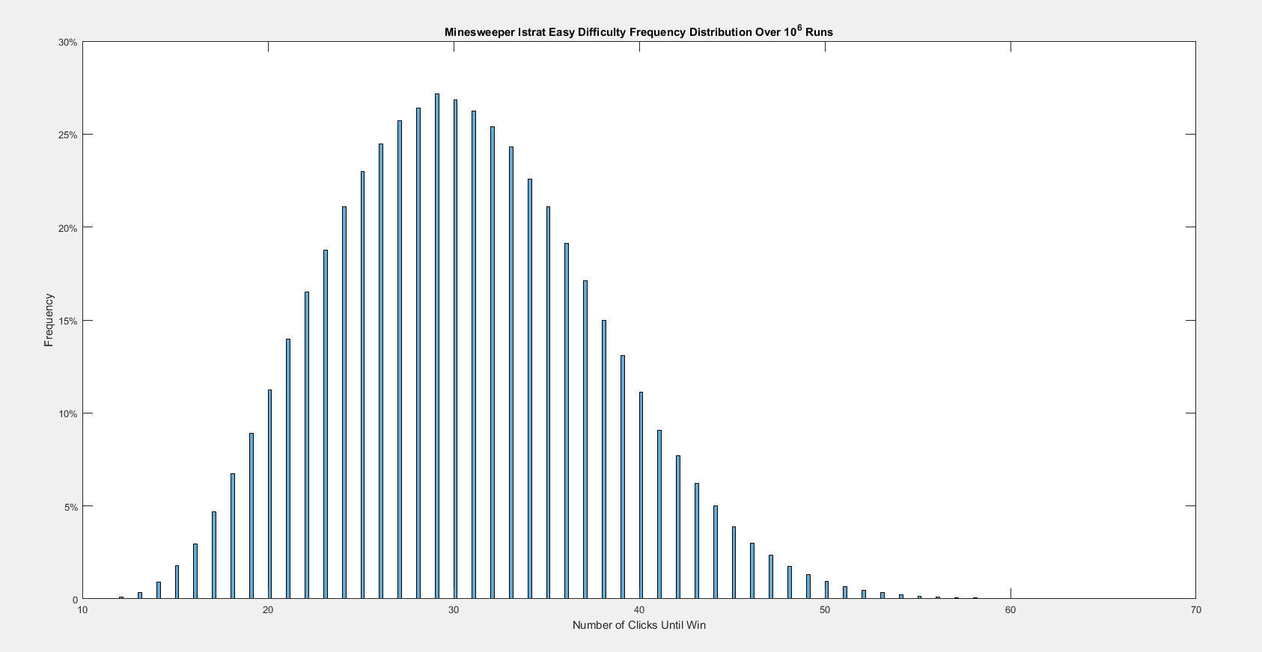
Wins .
Notes:
10^6 wins not runs

Slide 14

Hardships/Struggles
Takes a long time to run
Updating the compBoard with correct revealed values
Recursion with zerosInSquares function
Creating the Flagging strategy
Notes:
Michael

Slide 15
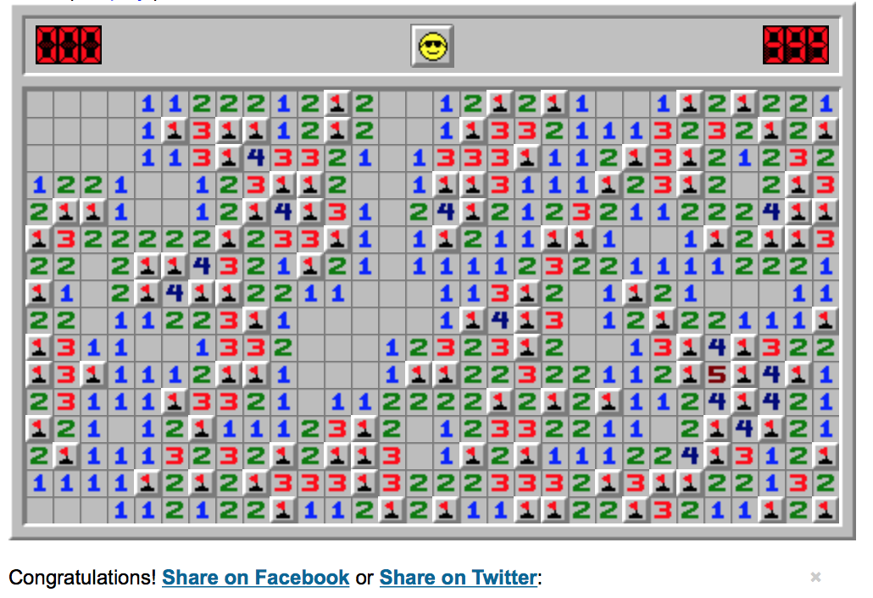
Final Thoughts
Add and improve strategies
Optimizing code
Increase number of runs to find more frequency distributions
Using parallel computing
AI learning
Make a playable version
Notes:
Bryan

